Slide 1
ARPA, CHILDRENS AND AIR QUALITY
Educate to live in a better environment
PRACTICAL EXPERIENCES

Slide 2
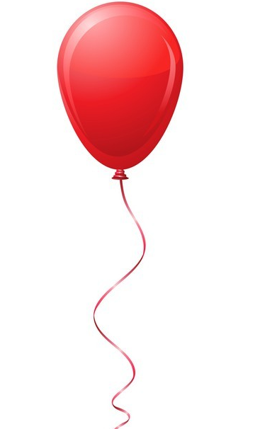
The importance of practical experiences
in teaching
-They stimulate attention
-They help understand concepts and memorize them
-They make the children feel an "active part" of the lesson

Slide 3
Experiments on air and its properties
The atmosphere is composed of different gases:
-A gas is capable of blowing out a candle
-... and to inflate a balloon
-To understand acid rain ...
The air is there even if you can't see it:
-A box full of ...
-The air is made up of many particles that cannot be seen ...
-In the water without getting wet!

Slide 4
The air exerts a force
-The sheet of paper that "floats" in the air
-The balloon that "runs" on the wire
-How does a straw work?
Air occupies a space
-The sponge that makes bubbles
-The syringe
-An empty bottle in the water ...
-The water that rises in the glass
Air has a weight
A balance for the air
... a jellyfish in the bottle!

Slide 5
The atmosphere is made up of different gases:
A gas capable of blowing out a candle
What you need: glass bowl, candle, baking soda, vinegar, match
-put a little baking soda in the bowl, place the candle on the bottom and add the vinegar: the flame goes out.
.
Explanation: a chemical reaction takes place between baking soda and vinegar with the formation of CO2 which causes the flame to go out.

Slide 6
… and to inflate a balloon:
What you need: bottle, bicarbonate, vinegar, balloon
-Place a little bicarbonate on the bottom of the bottle
-Pour some vinegar into the bottle
-Quickly thread a balloon onto the neck of the bottle
Explanation: a chemical reaction takes place between vinegar and baking soda which produces CO2. Like all gases, carbon dioxide also expands by inflating the balloon to occupy the space inside.

Slide 7
To understand acid rain ...:
What you need: saucer (plastic or glass), chalks, lemon juice, coca cola, detergent, concentrated citric acid, plastic pipettes
-Break a piece of chalk on the saucer
-Pour a few drops of the various more or less acidic liquid substances on each piece and observe what happens
Explanation: the acid substances dissolve the chalks more or less quickly. By analogy, acid rains are able to crumble the material from which buildings, monuments, etc. are made.

Slide 8
The air is there even if you can't see it
A box full of ...:
What you need: plastic box, cardboard, etc., various objects (games, pens, etc.)
-Put the different objects in the box and ask the children in turn to answer the question "what's in the box? How many things that take up space do you count? “
Explanation: children will almost certainly respond by counting only the objects in the box, forgetting the air that fills the empty spaces. It will be our task to give a correct explication in this regard.

Slide 9
The air is made up of many particles that cannot be seen ...
The air is a mixture of gases: 78% NITROGEN, 21% OXYGEN, 1% OTHER
GASES AND POLLUTANTS
What you need: marbles of different colors according to the different components, for example 78 blue, 21 green, 1 red
Explanation: visualize the abstract concept that air is made up of atoms and molecules, which are not seen because they are very small but which are
there.
Pollutants, in percentage are few but extremely harmful to our health!

Slide 10
In the water without getting wet!
What you need: water, tray, glass cup, sheet of paper
-Put the crumpled sheet of paper in the glass and dip it upside down in the tray full of water until it touches the bottom: when we take it out, it remained dry.
Explanation: The air contained in the jar prevents water from entering and reaching the paper.

Slide 11
The air exerts a force
The sheet of paper that "floats in the air":
What you need: two sheets of paper of exactly the same size
Take the two pieces of newspaper and cut one into a ball shape.
Raise your arms and drop them both at the same time.
Explanation:
The flat sheet floats in the air and descends more slowly than the crumpled paper. The air offers resistance to the movement of things. The larger the surface on which the air presses, the more difficult it is for a body to move in the air

Slide 12
The balloon that "runs" on the wire:
What you need: thread, straw, balloon, scotch tape
-Fix a plastic straw on the surface of a balloon with adhesive tape; passes a thread through the straw
-The thread must be kept tight by two people; inflate the balloon and let it go
Explanation: note how the air is able to exert a force, allowing the balloon to move along the wire

Slide 13
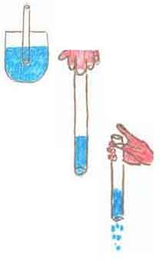
How does a straw work?
What you need: glass, straw, water, syrup for colored drinks
-Color a little water with a syrup for drinks and put the straw in the glass; suck a ittle water through your mouth into the straw.
-Close the top of the straw with your finger and remove it from the liquid. What happens?
-Then remove your finger from the mouth of the straw and observe.
Explanation: the finger decreases the air pressure above the straw. The increased air pressure under the straw prevents water from escaping

Slide 14
Air occupies a space
The sponge that makes bubbles
What you need: bowl, sponge, water
-Fill the bowl with water
-Immerse the sponge and squeeze it: bubbles will form in the water.
Explanation: This is possible because, in the sponge, there were air particles, although invisible. On contact with water, however, they became visible.

Slide 15
The syringe
What you need: syringe, water
-Aspirate the air with the syringe by pulling the piston outwards.
-Plug the hole with your finger and try to retract the piston which can only descend for a certain distance
Explanation: the air is elastic, compressible and takes up space. By doing the same test with water, the piston does not move: the water is not compressible.

Slide 16
An empty bottle in the water ...
What you need: empty plastic bottle, basin, water
-Immerse the bottle in water holding it with the mouth facing downwards: bubbles form
Explanation: the bottle, in reality, was not empty but full of air: the air is everywhere, even if you don't see it.

Slide 17
The water that rises in the glass
What you need: a candle, a glass, a basin, water, a match, colored
juice
-Secure the candle to the bottom of the bowl with drops of wax
-Add the colored juice to the water contained in the bowl
-Light the candle and cover it with the glass: the candle goes out after a while and the water goes back to the glass
Explanation: the candle goes out because the oxygen is consumed during combustion and the water goes back to the glass and occupies its place.

Slide 18
Air has a weight
A balance for the air
What you need: two balloons of the same size, hanger.
-Inflate the two balloons and tie them to the hanger.
-When in balance, deflate one of the two balloons: the hanger tilts
towards the part of the balloon that has remained inflated.
Explanation: the air closed inside the balloon makes it heavier than the deflated one.

Slide 19
A jellyfish in the bottle!
What you need: empty plastic bottle, water, balloon
-Insert a balloon in a bottle, inflate it and close its end.
-Fill the bottle with water and plug it. While turning the bottle upside down, the balloon will always position itself in the highest part.Una medusa in bottiglia!
!! It is possible to create a bottle with marine-themed designs: our balloon has become a jellyfish ...!!
Explanation: the air is lighter than the water so the balloon floats in the water.

